Slide 1
MOBILE PROGRAMMING PROJECT
Members:
Nguyen Manh (leader)
Nguyen Thanh Long
Le Thi Tuong Vy
Dinh Thi Hoa

Slide 2
About project
This is an application about foods ordering.
User can register, login, logout, view homepage, view detail, add to cart, order.
Link git: https://github.com/nguyenthanhlong11/Prototype-MobleProject-XD.git

Slide 3
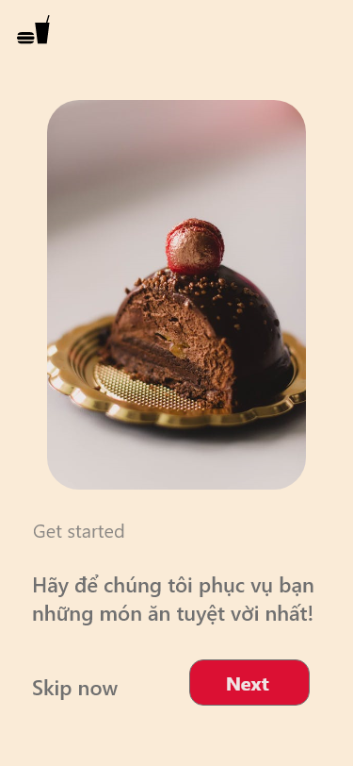
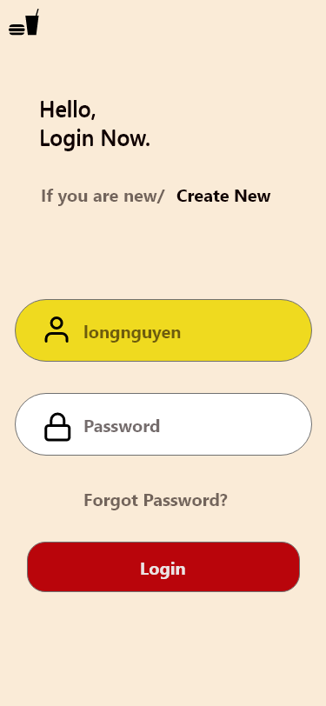
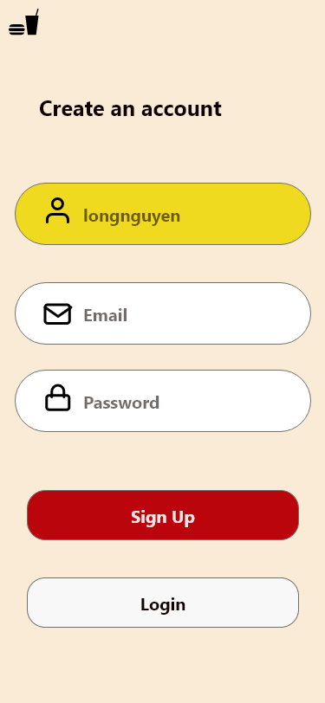
Interface

Slide 4
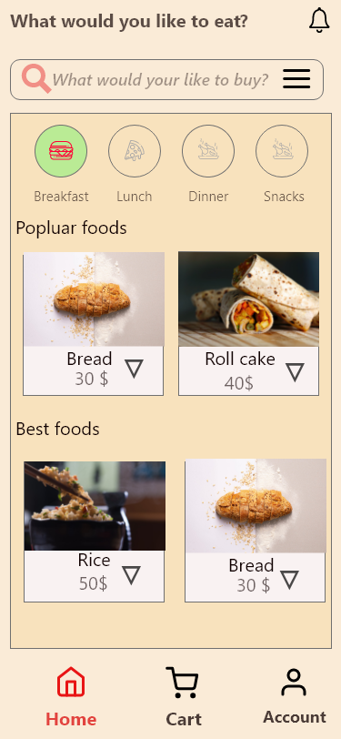
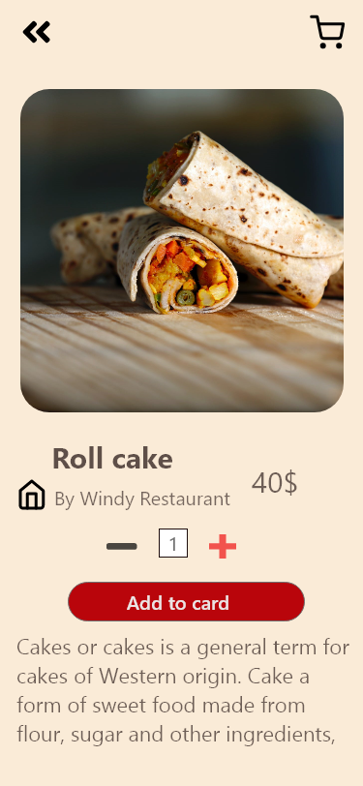
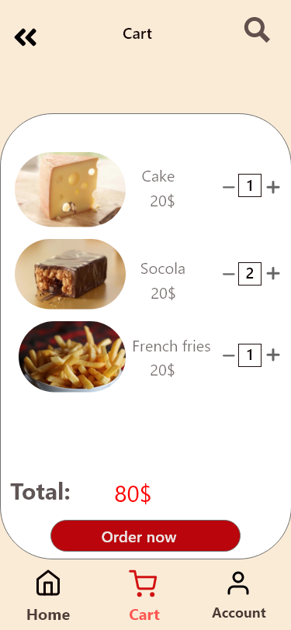
Interface

Slide 5
Target
Consolidate the knowledge learned and applied to the project. Build a complete food app with basic functions such as:
Login. logout, register
View detail/homepage
Add to cart, Order

Slide 6



Tools

Slide 7


